Slide 1


Immersive Python Workshop
August 14, 2025
Introduction to Python for GIS
Presented by the
UT Libraries &
Open Source Program Office (UT-OSPO)
UT-OSPO
UT Austin Open Source Program Office
Sloan grant number: G-2023-20944

Slide 2
Goals for this Workshop
Highlight useful freestanding GIS packages on Python
Introduce workflows for Vector and Raster data
Provide sources for spatial data and explain how to access/manipulate with python

Slide 3

What is GIS?
Geographic – Relates to a specific location on the Earth’s surface
Information – Data that has some value added
Systems – System that performs functions with geographic data

Slide 4
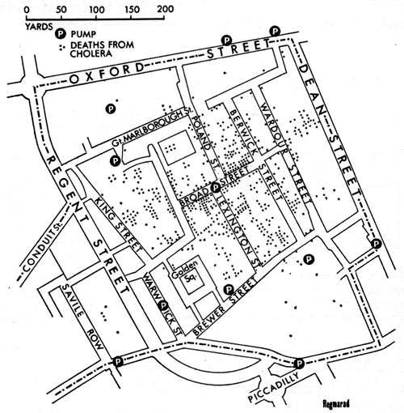
Why is GIS Important?
Helps solve geographic problems
Location is either used to help find a solution or is the solution itself
Examples: “Where did the flooding occur?”
“Where should I open my business?”
“Why are cases of Cholera clustered?”
John Snow’s Cholera Map, 1854

Slide 5
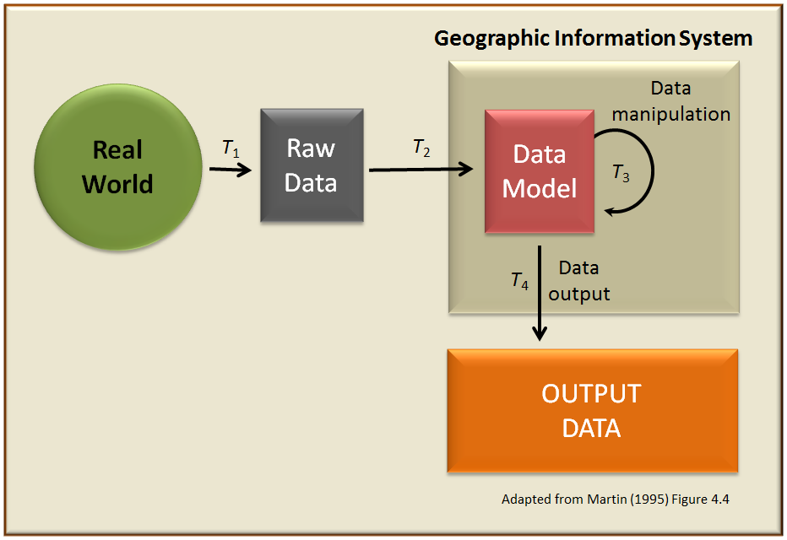
What is GIS?

Slide 6

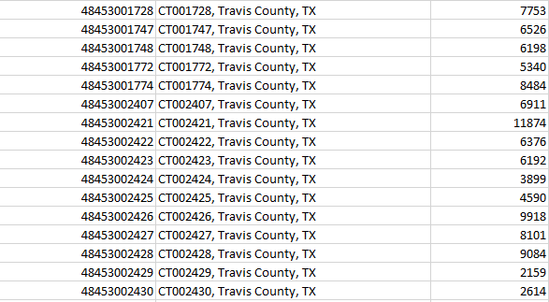

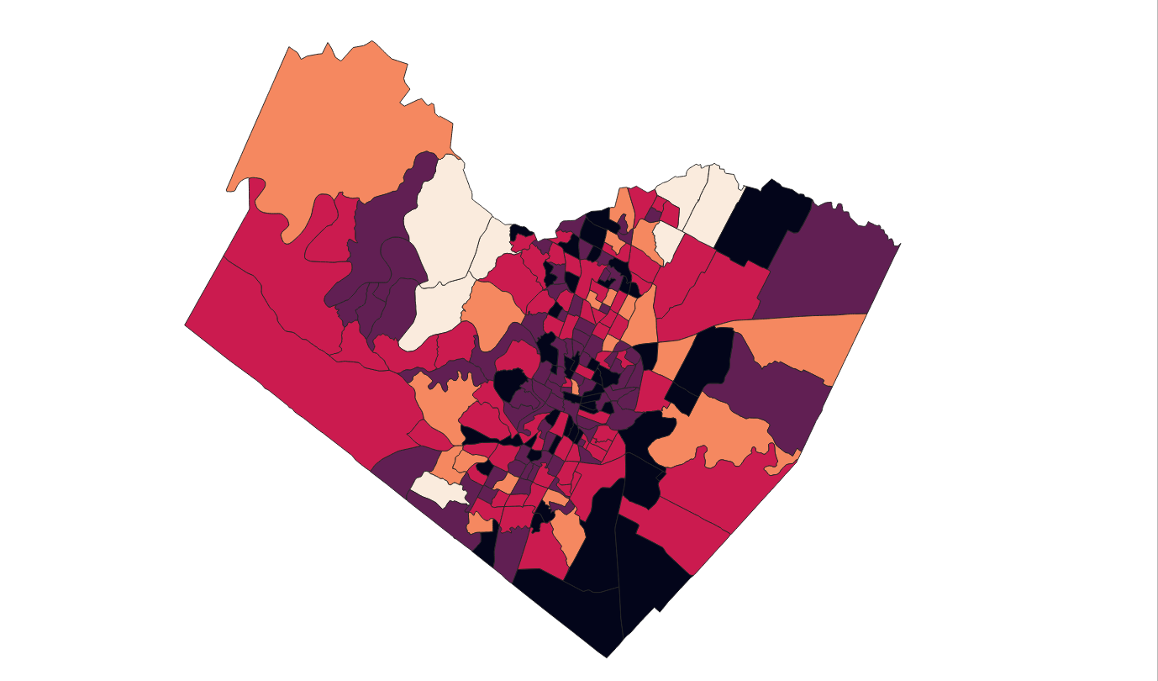
What is GIS?
Real World
Raw Data
Data Model
Data Manipulation
Output

Slide 7
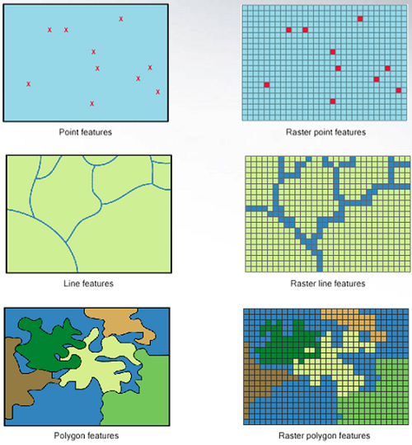
GIS Data Models
How do we represent geographic space with data?
Two different types of models
Vector
Raster
Vector is normally used for discrete features
e.g., roads, lakes
Raster is best for continuous features
e.g., elevation, land cover type`
Courtesy: Humboldt State

Slide 8
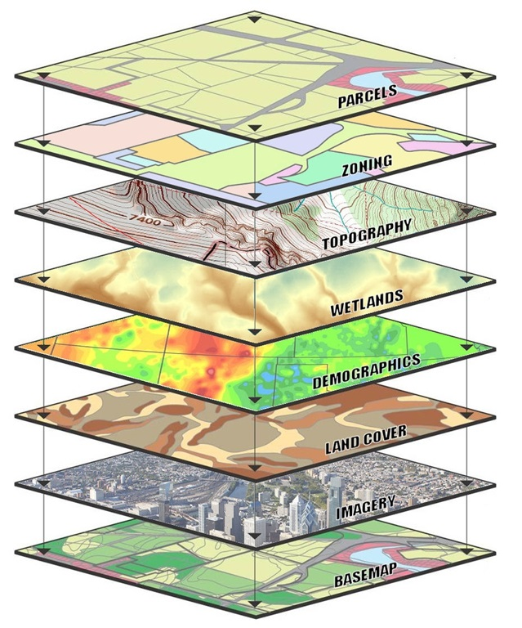
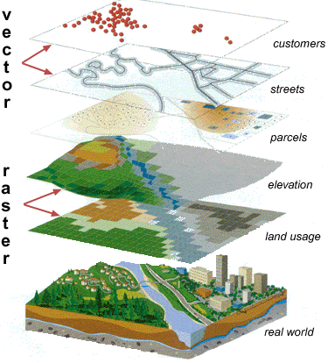
GIS Layers
Carlton
USGS

Slide 9
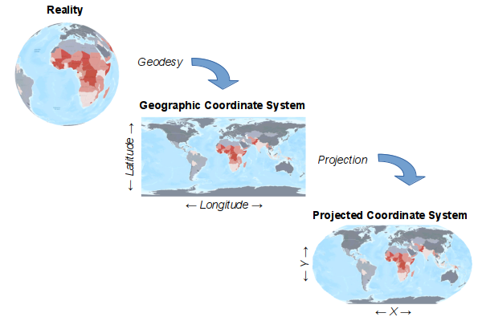
Coordinate Systems
To understand where something is we need uniquely defined locations for all points on earth
A geographic coordinate system uses a three-dimensional spherical surface
E.g., Lat/Long = 30.282, -97.738
A projected coordinate system employs a conversion from Lat/Long to X/Y on a planar system

Slide 10
Why is open source important in GIS
Traditionally dominated by proprietary software (Esri) in the US
It is still important to know Esri ArcGIS software for the GIS professional market in the US
However, there are great open source alternatives!
These open source softwares are free to use and globally popular
Analyses performed with open source software have higher reproducibility
Unlike ArcGIS Pro, open source GIS software generally works on Macs

Slide 11





What software should I recommend?
Desktop Interface
Script-based
Web-interface
QGIS
Python
ArcGIS Online
R
ArcGIS Pro

Slide 12
What software should I recommend?
Desktop Interface
Script-based
Web-interface
QGIS
Python
ArcGIS Online
R
ArcGIS Pro

Slide 13
*Assuming institutional access to ArcGIS products and a non-programming background
ArcGIS Online
Accessibility
ArcGIS Pro
QGIS
R
Python
Flexibility

Slide 14

GIS in Python
Example Python GIS Packages
GeoPandas: Important library for working with vector based geospatial data in Python
GDAL: Translator library for a wide variety of raster and vector data formats.
GeoWombat: Provides utilities to process geospatial and time series of raster data at scale. Easily process Landsat, Sentinel, Planetscope or RGB data and others.
Rasterio: Provides functionality for GeoTIFF and other formats to organize and store gridded raster datasets such as satellite imagery and terrain models.
OSMnx: Allows users to easily download, model, analyze, and visualize street networks and other geospatial features from OpenStreetMap.

Slide 15
GIS in Python
Other Packages We’ll Use Today
MatPlotLib: comprehensive library for creating static, animated, and interactive visualizations.
urllib: provides several modules for working with URLs:
Sklearn-xarray: A powerful machine learning package

Slide 16
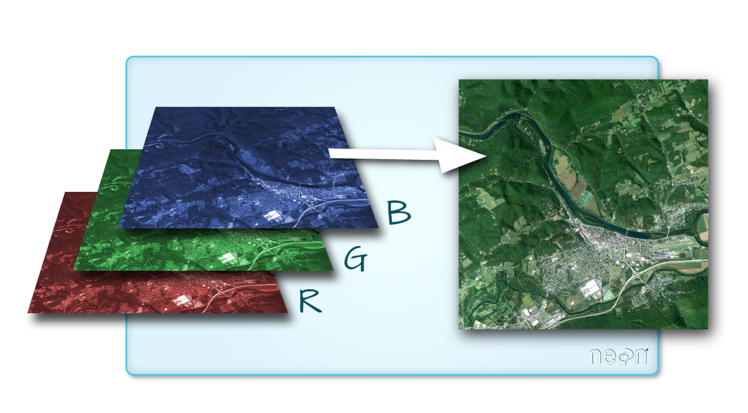
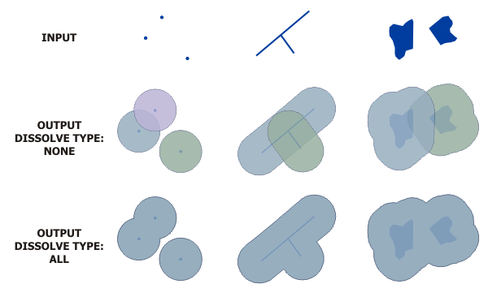
Important Concepts for today
Vector versus Raster
Openstreetmap Data
Multiband Satellite Imagery
ArcGIS

